Slide 1

BFPT Ultrasonics GmbH
Special Solution for Fish Farming Cleaning Process
Dr. Jie-Wei Chen
Sarnen, Switzerland
8. January 2018
CONFIDENTIAL

Slide 2
Introduction
2
The feasibility study will have the focus on the physical characterization of special designed wire transducer for the application of fish farming. Based on the application requirements, a large size of area or volume of acoustic vibration in sea water needs to be generated, which should not only be homogenously, but also be strong enough for preventing purpose. Our proposal is to generate an acoustic curtain, which covers mainly the fish network and without touching the space inside of the fish network. For this purpose we design a special wire transducer, which can be easily formed for fitting the protected object exactly. Therefore, we’ll design a transducer with longitudinal vibration mode and to transfer this vibration to a second part of transducer with transverse vibration mode. The long length of wire transducer will be used for forming useable target area od volume, where the prevention effect is expected. For the real implementation later on, the special transducer part A and part B will be firstly simulated and designed. The physical properties will be characterized through acoustical and optical methods, for example, the possible effective length of wire transducer, the size of effective zone, the the vibration frequency, the expected amplitude of transducer and target medium (sound pressure). All these knowledge will be applied to a real testing system with sea water. Further design for a real prototype in Norway fish farming will be investigated. The result and the related equipment could be also used for the second phase of feasibility in Norway.
CONFIDENTIAL

Slide 3
Confidentiality & Non-Disclosure
2
This presentation contains proprietary and confidential information. All data and information submitted to the receiving party is provided in reliance upon its consent not to use or disclose any information contained herein except in the context of its business dealings with MPI Solutions. The recipient of this document agrees to inform present and future employees of receiving party who view or have access to its content of its confidential nature.
CONFIDENTIAL

Slide 4
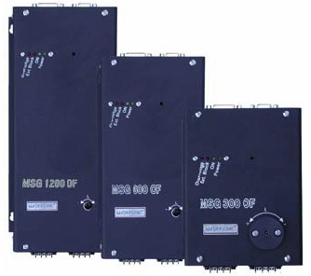
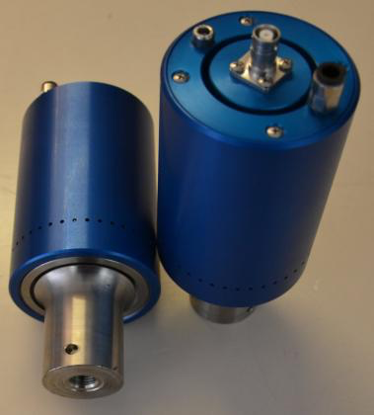
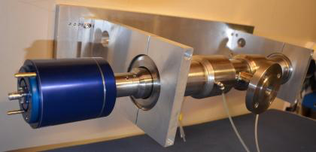
Technology
3
Patented Ultrasonic Generator
Patented Transducer Design
New Improved Applications
+
=
CONFIDENTIAL

Slide 5
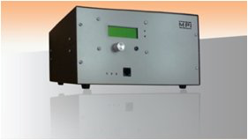
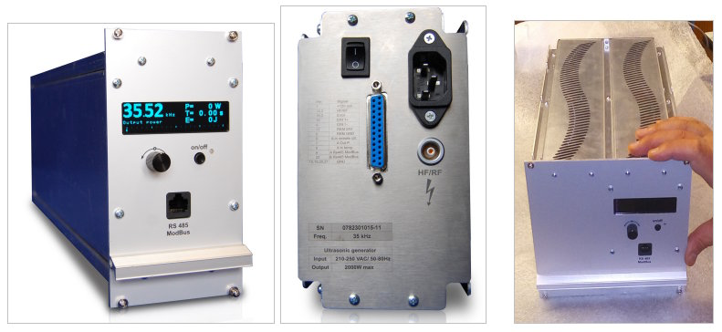
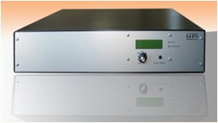
Technology (generator design)
4
MPI has developed the patented multi-frequency, multimode, modulated sonic & ultrasonic system (also known as MMM). The system generator represents a brand new approach in sonic and ultrasonic power supplies and equipment.
CONFIDENTIAL

Slide 6
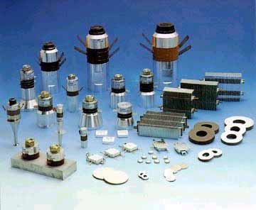
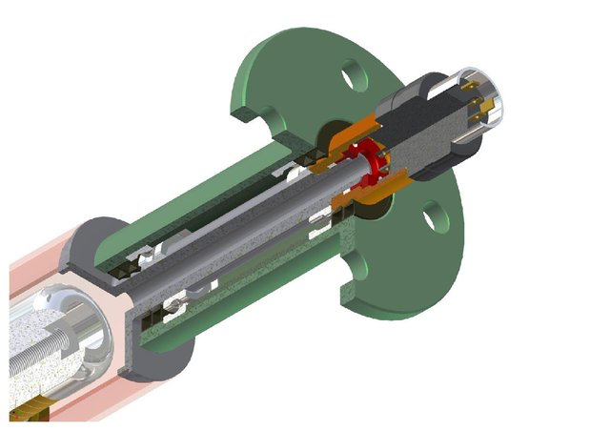
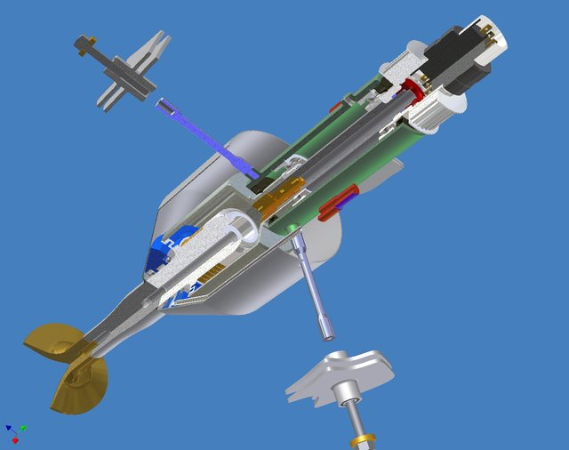
Technology (customized transducer design)
5
The unique MPI transducer is custom designed according to its application and is coupled according to patented methods. This, when applied in combination with the MMM generator, results in solutions giving rise to a vast expansion of possible applications and a vast improvement in its effectiveness.
CONFIDENTIAL

Slide 7
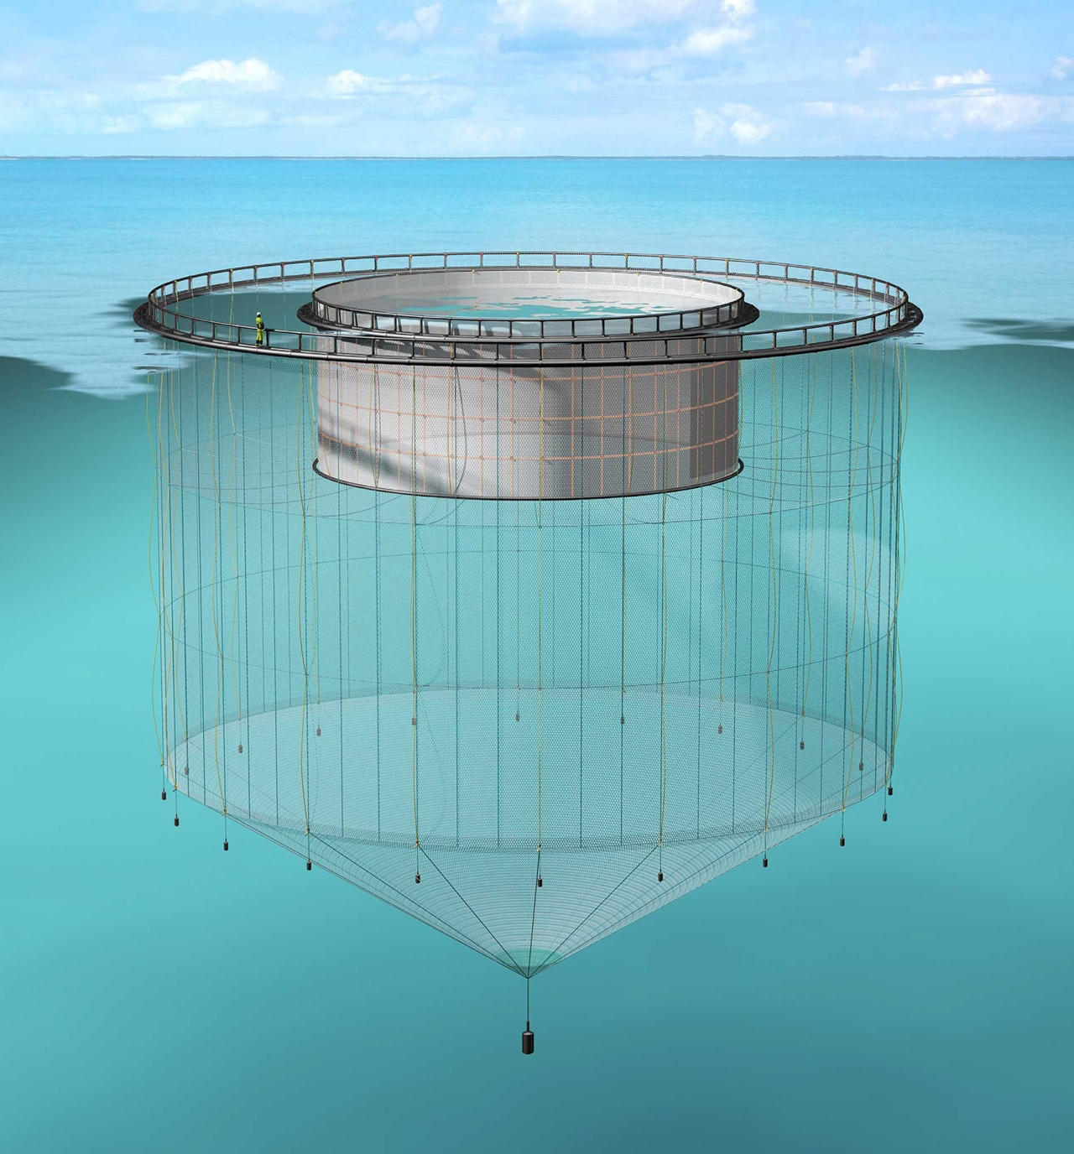
Applications “Fish Farming” (Acoustic Curtain)
6
Fish Farming devices are normally situated at sea and in Norway alone there are 40,000 such enclosures, each one having a product value of several million Euros. There are many unsolved problems of disease, fouling of nets and enclosures and of pollution in this industry . All existing cleaning methods and systems are very limited.
MPI Solutions has developed a ground-breaking solution.
Ongoing:
Basis Patent Applications
Preparing of collaboration (JV) with negotiation
Preparing of the feasibility phase (I)
Collaboration with Norwegian based Fish Farm supplier
Collaboration with Norwegian Research Council
Collaboration with SINTEF R&D, Norway
CONFIDENTIAL

Slide 8
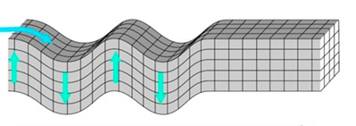

Optical Vibration Characterization of Transducer
8
acoustic transducer A
acoustic transducer B
vibration direction A
vibration direction B
A
A: amplitude of vibration,
a few micro meters
CONFIDENTIAL

Slide 9
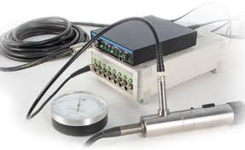
Acoustical Characterization of the Vibration Effect
7
acoustic transducer A
acoustic transducer B
sea water
vibration direction A
vibration direction B
vibration of sea water
sound pressure measurement
Hydrophone
width of effective zone
CONFIDENTIAL

Slide 10
Geometry Optimization of Transducer
9
acoustic transducer part A
different types of transducer B will be investigated, with the focus on the vibration characteristic of transducer part B.
acoustic transducer part B
cylinder form and tube form have different vibration effect. The optimized shape of transducer will be applied in the trail.
CONFIDENTIAL

Slide 11
Determination of effective Zone
9
acoustic transducer part A
Different types of transducer B will be investigated, with the focus on the size of effective zone of vibration.
acoustic transducer part B
D2
x
x
D1
y
y
CONFIDENTIAL

Slide 12
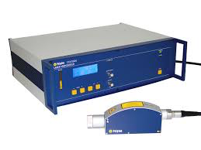
Determination of Attenuation for Transducer B
10
The attenuation along the transducer part B will be investigated by using laser vibrometer, which provides the information about the max. length of the useable wire transducer.
laser vibrometer
laser vibrometer
acoustic transducer part A
acoustic transducer part B
p1
p2
p3
p4
p5
p6
p7
p8
p9
p10
Amplitude (micrometer)
distance (meter)
p1
p2
p3
p4
p5
p6
p7
p8
p9
p10
CONFIDENTIAL

Slide 13
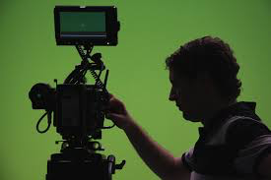
Testing System with Real Sea Water Conditions
11
generator 3
generator 1
generator 2
testing option 3
testing option 2
testing option 1
Parameters for options:
frequency
acoustic power
time duration of illumination
wire forms
CONFIDENTIAL

Slide 14
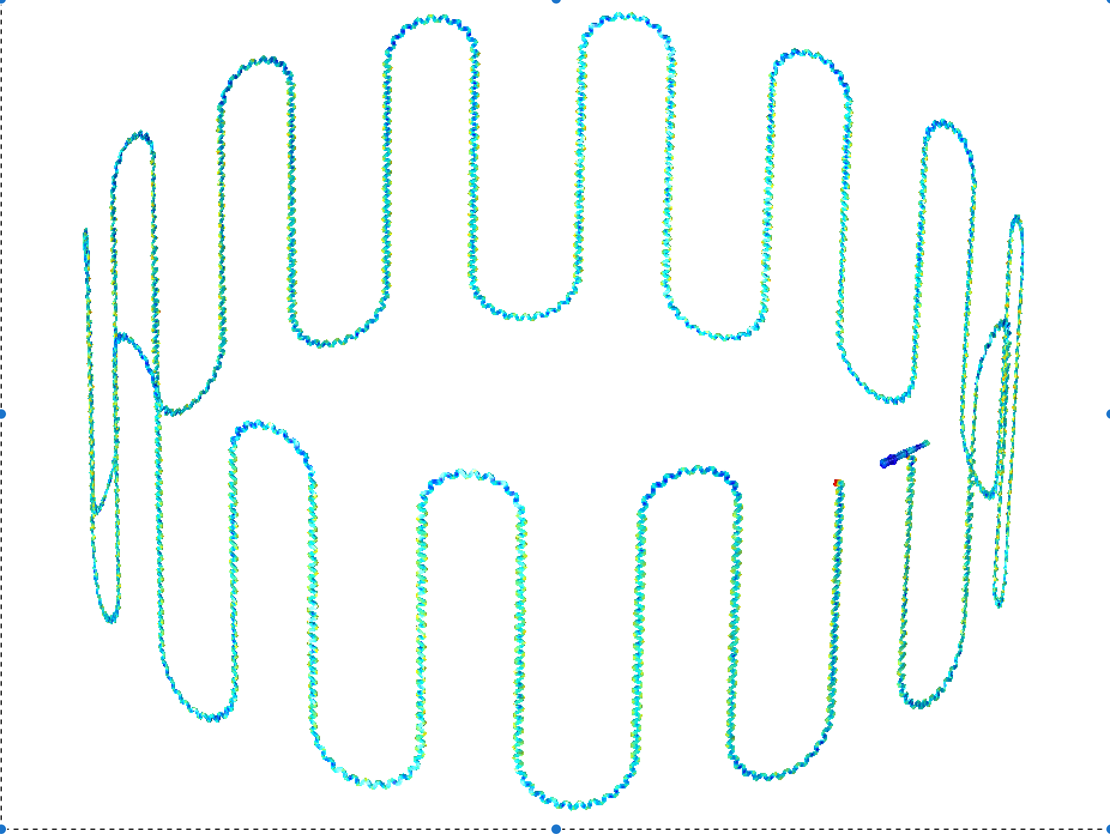
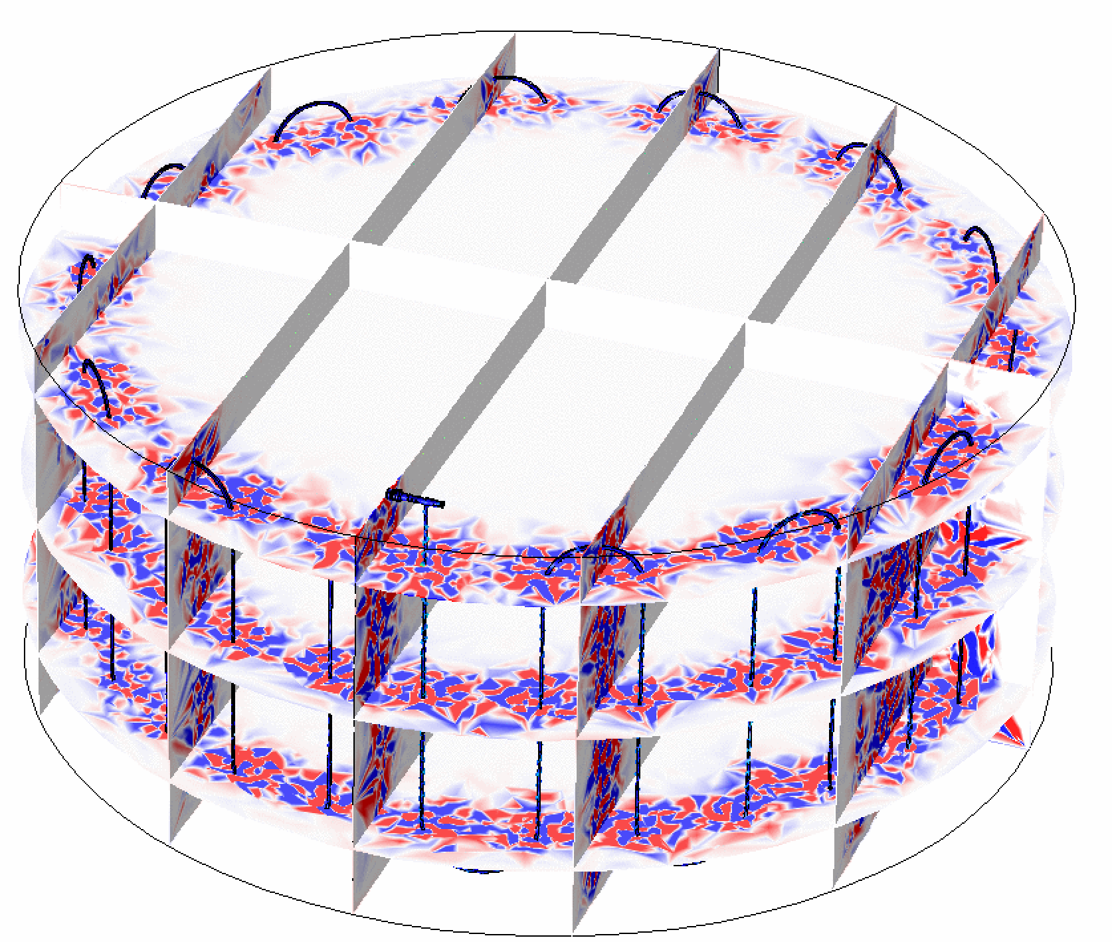
Simulation and Design of specially formed Wire Transducer B
12
Simulation for transducer (main part, part A)
Simulation for wire transducer (part B)
Simulation for forming of wire transducer
CONFIDENTIAL

Slide 15
Thank You
14
CONFIDENTIAL

